Slide 1

SALES INSIGHT
Presented by : K. AJAY KUMAR
ROLLA DHANUSH REDDY
MIRZA AZMATH BAIG

Slide 2
About Adventure Works :
Adventure Works Cycles, the company on which the Adventure Works sample databases are based, is a large, multinational manufacturing company. The company manufactures and sells metal and composite bicycles to North American, European and Asian commercial markets. While its base operation is in Bothell, Washington with 290 employees, several regional sales teams are located throughout their market base.
In 2000s, Adventure Works Cycles bought a small manufacturing plant in Mexico. Which manufactures several critical subcomponents for the Adventure Works Cycles product line. These subcomponents are shipped to the Bothell location for final product assembly. In 2001, this manufacturing plant became the sole manufacturer and distributor of the touring bicycle product group.

Slide 3
Coming off a successful fiscal year, Adventure Works Cycles is looking to broaden its market share by targeting their sales to their best customers, extending their product availability through an external Web site, and reducing their cost of sales through lower production costs.
Business problem

Slide 4
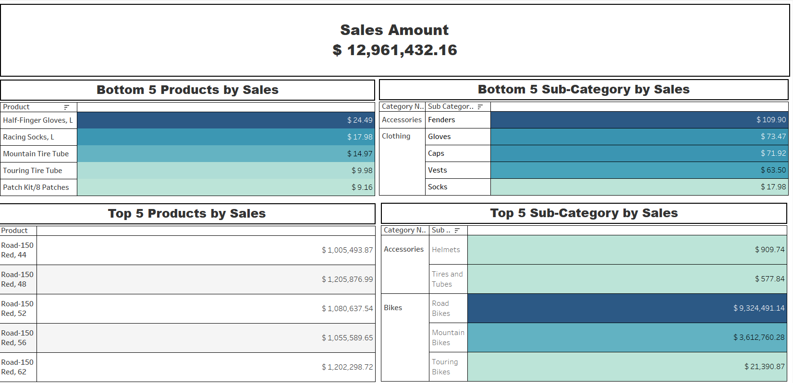

Slide 5
Sales Analysis
1.Total Sales:
The total sales amount stands at $12,961,432, highlighting significant business potential.
2.Top Products by Sales:
Road-150 Red series dominates, with all variants (sizes 44, 48, 52, 56, 62) contributing substantially.
Road-150 Red, Size 62 is the highest-selling product with $1,202,299 in sales.
3.Bottom Products by Sales:
Products like Half-Finger Gloves (L) with $24.49 and Mountain Tire Tube with $14.97 underperform.
The least-performing product overall is the Patch Kit/8 Patches, with only $9.16 in sales.
4.Top Sub-Categories by Sales:
Bikes category leads overall sales:
Road Bikes contribute the most, with $9,324,491 in sales.
Mountain Bikes follow, generating $3,612,760 in sales.
Within Accessories, Helmets are the top-performing sub-category with $910 in sales.

Slide 6
Sales Analysis
5.Bottom Sub-Categories by Sales:
Low-performing sub-categories include:
Fenders with $109.90 in sales.
Gloves with $73.47 in sales.
Socks have the lowest sales at $17.98.

Slide 7
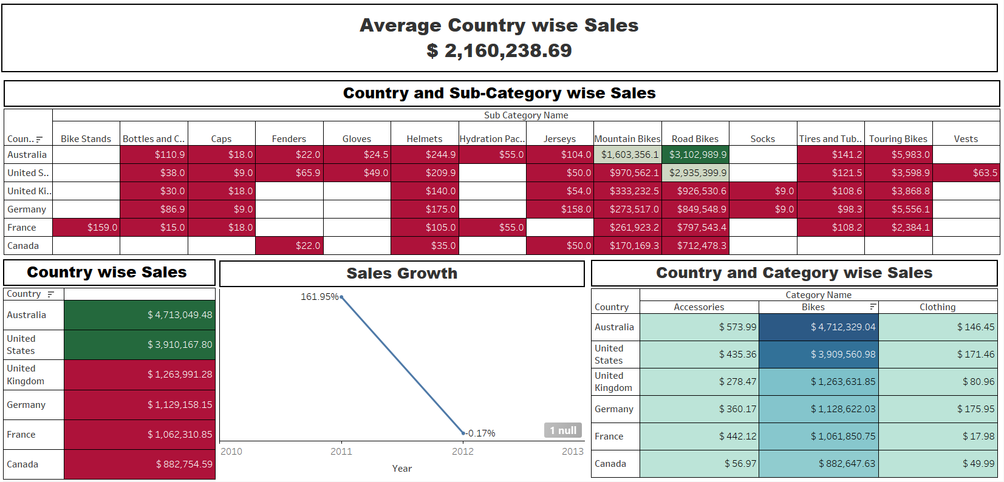

Slide 8
Country WiseSales Analysis
1.Average Country-wise Sales:
Average sales across all countries : $2,160,238.69.
2. Top Countries by Sales Performing Above Average Sales:
Australia leads with total sales of $4,713,049, dominating all categories.
United States follows with $3,910,168, showing strong performance in bikes.
3. Category-wise Sales:
Australia contributes $4,712,329 in Bike sales, followed by the United States with $3,909,561.
Australia with the Accessories category contributing $ 574.
For Clothing, Germany and the United States lead with $175.95 and $171, respectively, while France has the lowest sales at $17.98.
4. Sub-Category-wise Sales:
Road Bikes and Mountain Bikes dominate across all countries.
Australia: Road Bikes: $3,102,990, Mountain Bikes: $1,603,356.
United States: Road Bikes at $2,935,400.
Sub-categories like Socks, Fenders, and Caps show minimal sales contributions globally.

Slide 9
Country WiseSales Analysis
5. Regional Performance Insights:
Australia is the standout performer, with strong sales across most categories.
The United States is a strong competitor but lags behind Australia's overall numbers.
France and Canada underperform, with Canada recording the lowest sales at $882,755.
6. Underperforming Sub-Categories:
Across countries, Fenders, Caps, and Vests contribute minimally to sales.
Tires and Tubes and Touring Bikes also record low sales in most countries, with limited growth potential.
7.Sales Growth:
A significant increase in sales from 2010 to 2011 (+161.95%).
A slight decline in sales from 2011 to 2012 (-0.17%), signaling stagnation or market challenges.
8.Focus Areas:
Improve Regional Sales Performance by developing strategies to boost sales in underperforming regions and prioritizing high-potential sub-categories in these regions.
Address the 2012 Sales Decline by analyzing the market trends and external factors contributing to the 0.17% sales drop in 2012.
Expand Low-Performing Sub-Categories by introducing targeted promotions and region-specific campaigns for these products.

Slide 10
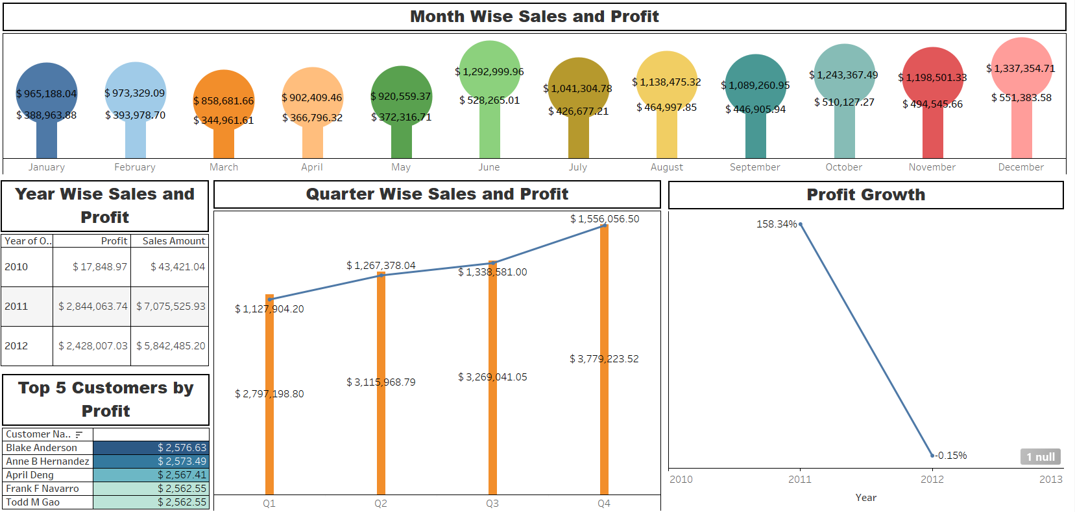

Slide 11
Month Wise Sales And Profit
1.Month-wise Sales and Profit:
June recorded the highest sales ($1,293,000) and profit ($528,265), making it the top-performing month.
December follows closely with $1,337,355 in sales and $551,384 in profit.
March had the lowest sales ($858,682) and profit ($344,962), followed by April ($902,409 in sales and $366,796 in profit).
2.Quarter-wise Sales and Profit:
March had the lowest sales ($858,682) and profit ($344,962), followed by April ($902,409 in sales and $366,796 in profit).
Q1 had the lowest performance in sales ($2,797,199) and profit ($1,127,904).
A steady increase in both sales and profit is observed from Q1 to Q3, with a significant jump in Q4.
3.Profit Growth:
2010-2011: Profit growth surged by 158.34%, reflecting strong business expansion.
2011-2012: A sharp decline in profit growth to -0.15%, highlighting challenges in maintaining profitability.

Slide 12
Month Wise Sales And Profit
4.Year-wise Sales and Profit::
2011: The best-performing year with sales of $7,075,526 and profit of $2,844,064.
2012: Decline in both metrics, with sales at $5,842,485 and profit at $2,428,007.
2010: The initial phase with minimal profit ($17,849) and low sales ($43,421).
5.Top 5 Customers by Profit:
Blake Anderson is the most profitable customer, contributing $2,576.63 in profit.
Anne B Hernandez follows closely with $2,573.49, making them key customers to focus on.
April Deng, Frank F Navarro, and Todd M Gao each contributed profits above $2,562, highlighting their importance as key customers.

Slide 13
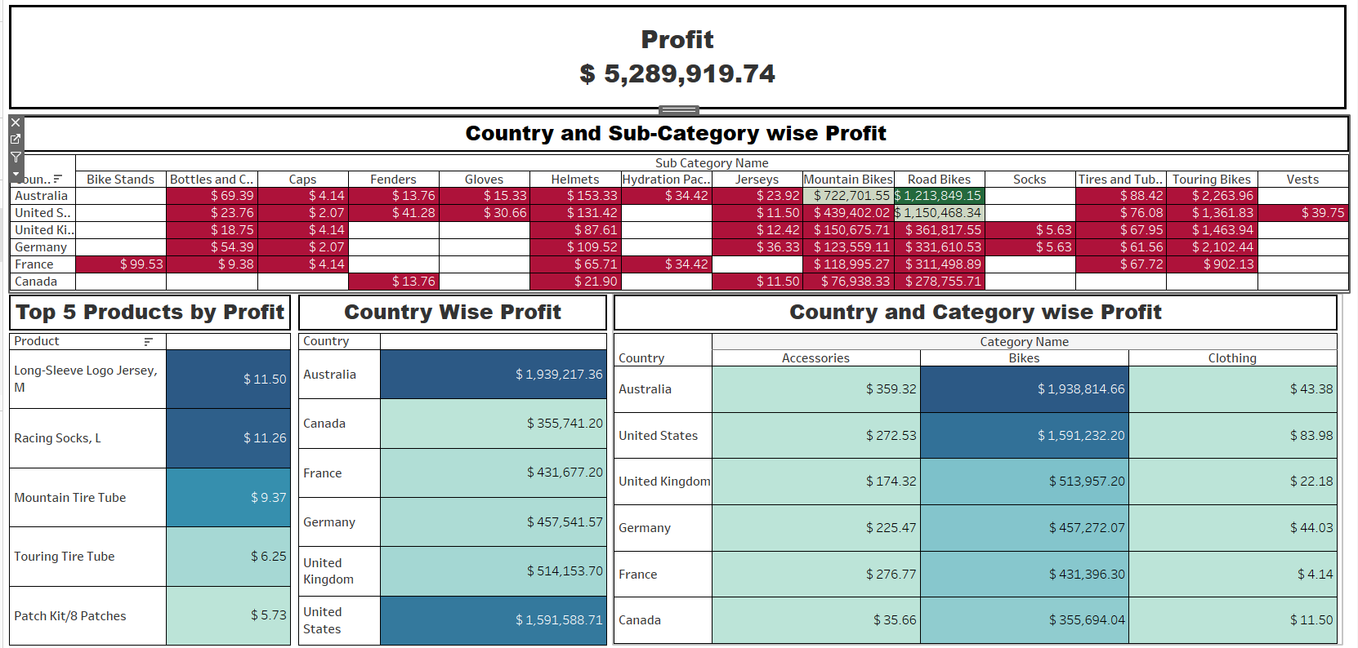

Slide 14
Country Wise Profit
1. Total Profit Overview:
The total profit achieved across all categories and countries is $5,289,920.
2. Country-Wise Profit Insights:
Australia is the highest contributor with a profit of $1,939,217, followed by the United States at 1,591,589.
The countries with the lowest profits are Canada ($355,741) and France ($431,677)
3. Top 5 Products by Profit:
The top products contributing to profitability are:
  Long-Sleeve Logo Jersey - $11,498
  Racing Socks, L - $11,255
  Mountain Tire Tube - $9,371
  Touring Tire Tube - $6,247
  Patch Kit/8 Patches - $5,734

Slide 15
Country Wise Profit
4. Category-Wise Profit Analysis:
Bikes category dominates in all countries, making the highest profit. For example:
  In Australia, bikes contribute $1,938,815 out of the total profit.
  In the United States, bikes contribute $1,591,232.
Accessories and Clothing show much lower profit margins compared to bikes.
5. Sub-Category-Wise Observations:
Road Bikes and Mountain Bikes generate significant profits:
  Road Bikes profit is highest in Australia ($1,213,849).
  Mountain Bikes profit in the United States is $439,402.
Other sub-categories like Helmets and Gloves show minimal contributions.
6. Country and Sub-Category Challenges:
Some sub-categories, such as Caps, Fenders, and Vests, generate negligible profits in most countries.
Canada consistently shows lower profits across almost all sub-categories.

Slide 16
Strategic Key Takeways
1. Sales and Profit Growth:
Both sales and profit show consistent growth from 2010 to 2012, signaling strong market demand and effective operations.
Strategic efforts should focus on maintaining this momentum while identifying areas to increase profit margins.
2. Best and Worst Performing Products:
Best Performers: High-performing categories like Road Bikes and specific models such as "Road-150 Red" have driven significant revenue.
Underperforming Products: Items like gloves and tire tubes lag behind, indicating a need to reassess their market fit, pricing, or marketing strategies.
3. Regional and Country-Wise Performance:
Top Markets: The United States leads in sales and profit contributions, followed by Australia and the UK. Regional preferences vary, with Bikes performing strongly in the US, while Clothing has potential in European markets like Germany and France.
Targeted regional campaigns can further boost sales.

Slide 17
Strategic Key Takeways
4. Customer Insights:
High-value customers like Blake Anderson and Anne B. Hernandez are key drivers of profit. Building loyalty programs and personalized marketing can strengthen these relationships and attract similar customer profiles.
5. Seasonal and Monthly Trends:
Fluctuations in monthly sales suggest opportunities to smooth revenue streams by introducing promotional events or campaigns during off-peak months.
6. Strategic Opportunities:
Product Development: Expand high-performing product categories while innovating in underperforming ones. Market Expansion: Leverage regional strengths while exploring untapped markets for growth.
Profit Optimization: Focus on cost management and pricing strategies to maximize profitability.

Slide 18
Thank you

